Slide 1


API ACTIVITIES

Slide 2

MEMBERS
01
Nithi Shree J
02
Vinayak Sharma
03
Saasvatha P M
04
Sarthak Wankhede

Slide 3



API
API stands for Application Programming Interface
An API helps to communicate and exchange data with server
How Postman is Helping us ?
Sends Message to server which is called Request
Server sends Message back which is called Response

Slide 4

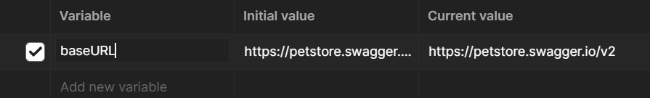
BASE URL
We have to allocate and inspect the server section through JSON file.
The ‘url’ field within the servers section represent the base URL
Eg: https://petstore.swagger.io/v2
This is the root URL to which all endpoint paths defined in the swagger file

Slide 5
ACTIVITY 1
Add Pet:
Add a pet with the following attributes
id: last 4 digits of your IBM Id
name: your name
status: add a creative status
Make sure the response indicates successful addition
Get the new Pet by status:
Using the status you added above, try to retrieve pets with such status
Verify that your pet is present in the response

Slide 6
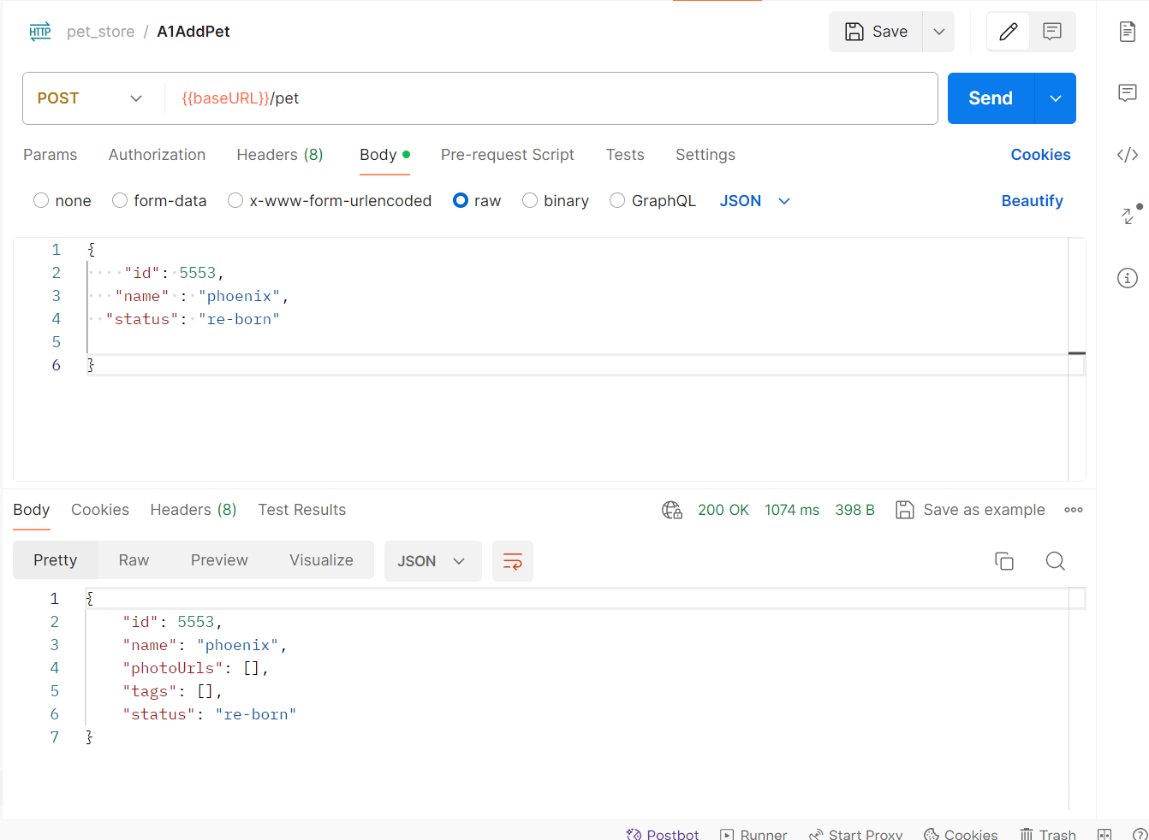


Slide 7
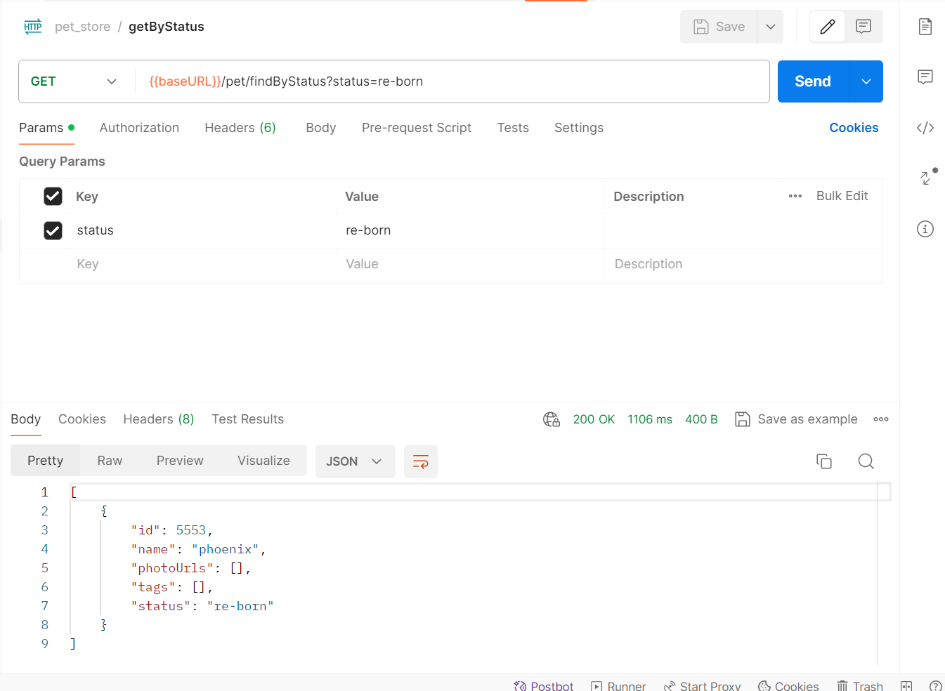

Slide 8
ACTIVITY 2
Add Pet:
Add a pet as above but randomize the pet ID

Slide 9


Slide 10
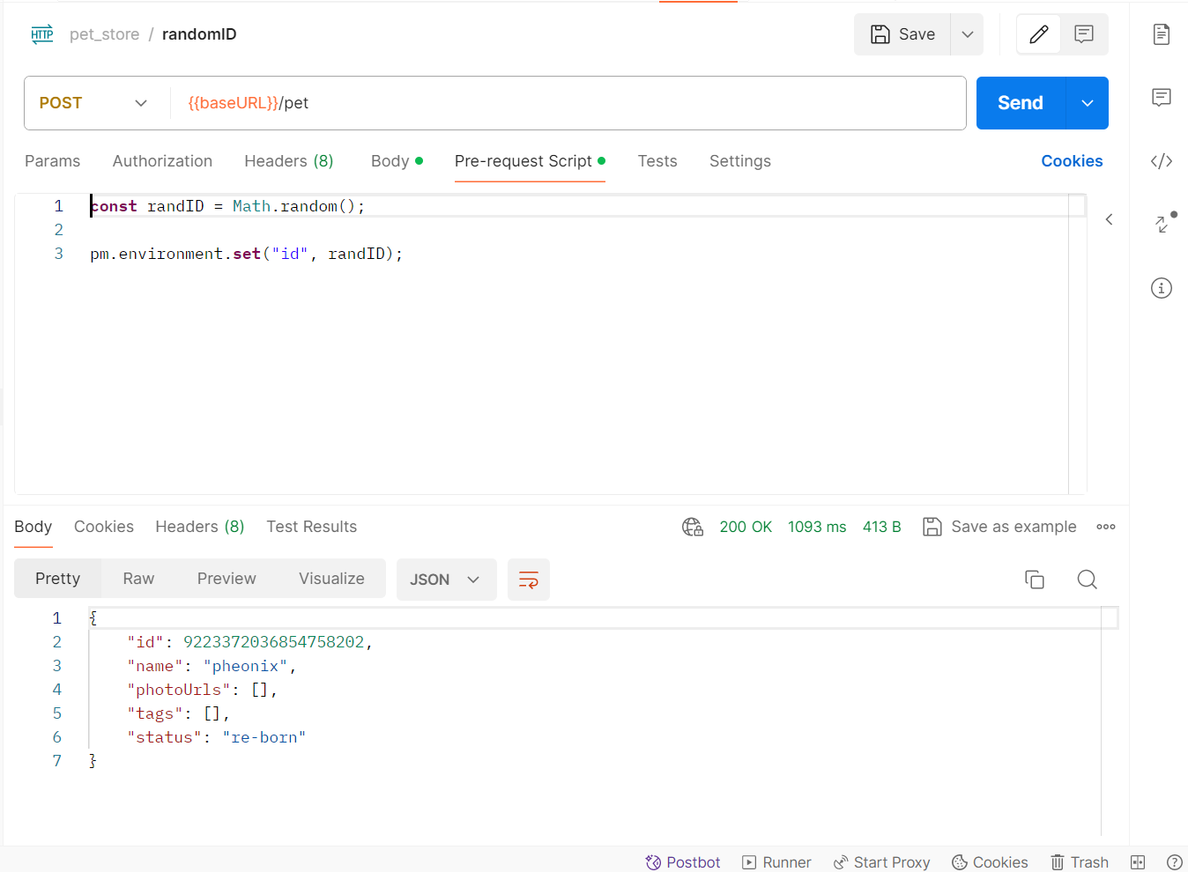

Slide 11
ACTIVITY 3
Add Pet:
Add a pet as above but randomize the pet Name as well as the pet Status based on a predefined set of values.

Slide 12
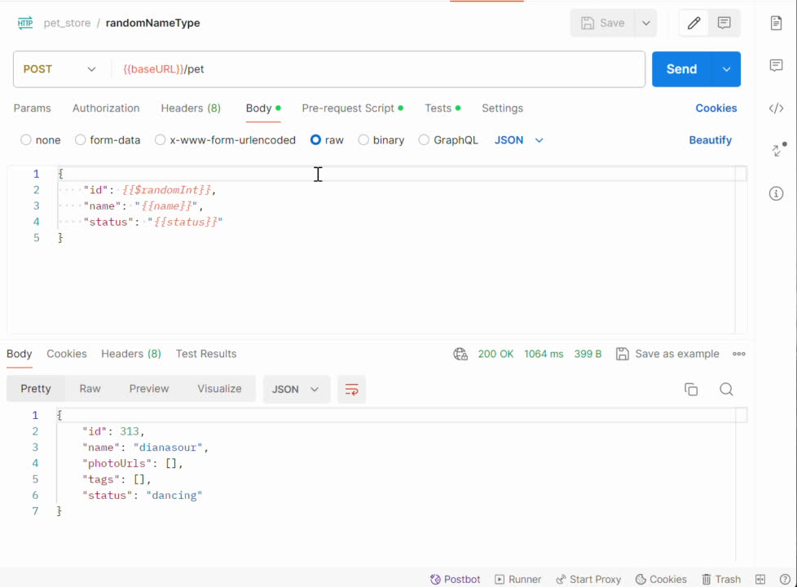

Slide 13
ACTIVITY 4
Get Pet variation:
For the POST request above where the pet id was randomized,
Run a GET request to get the details of the pet created, using the pet id. This should be automated, not manual key-in of the pet id.

Slide 14
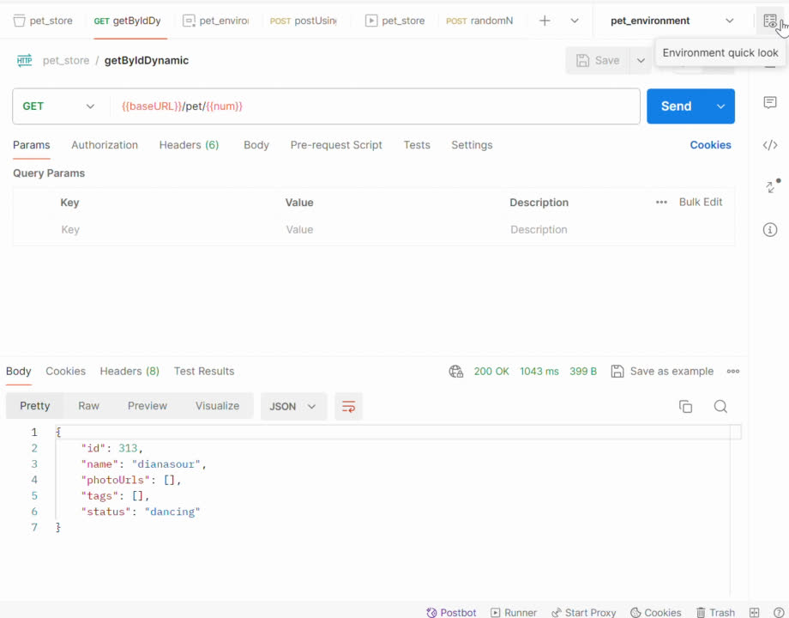

Slide 15
ACTIVITY 5
Post/Get/Put/Delete operations together:
Building on top of above, do the following sequence:
Post request as above, with randomized id, name and status
Get request to get the details of the pet added above
Put request to update the status of the pet created above
Get request to verify that the status is actually changed
Delete request to delete the pet
Get request to verify that the pet cannot be found
Use console.log to add informational messages throughout

Slide 16
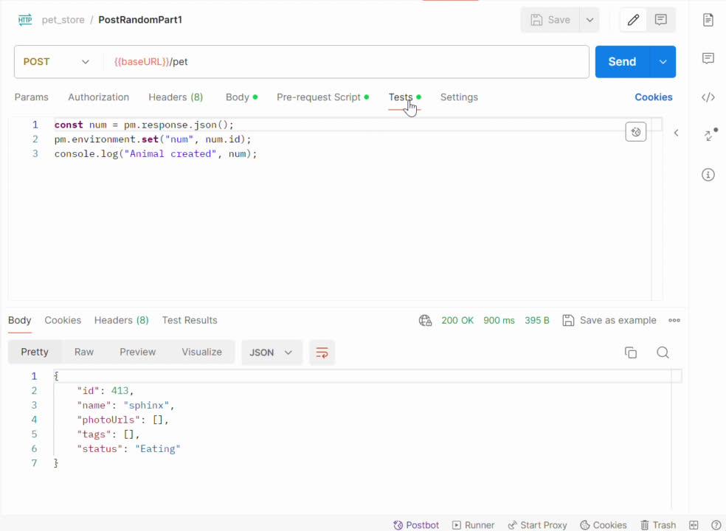

Slide 17
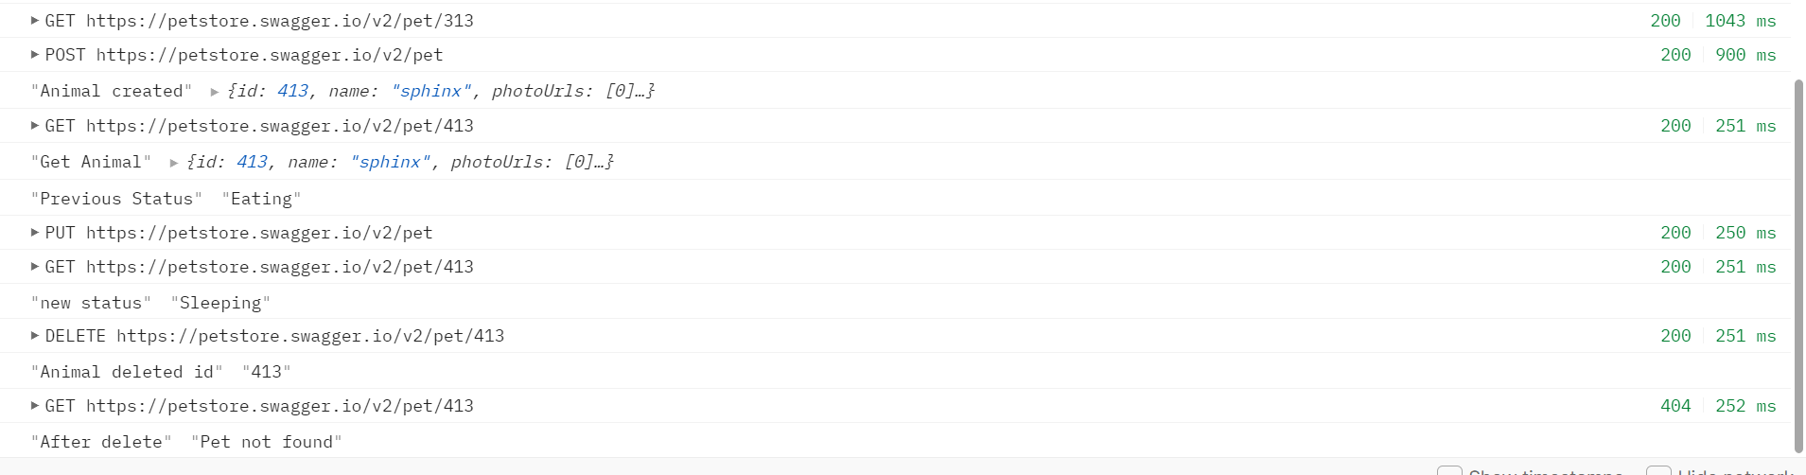

Slide 18
ACTIVITY 6
a) Create a CSV file with test data as shown.
b) Use the CSV test data to create POST requests
c) Use console.log to write the data being used during each request.

Slide 19
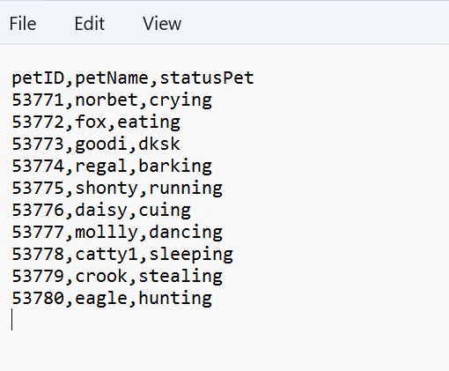

Slide 20
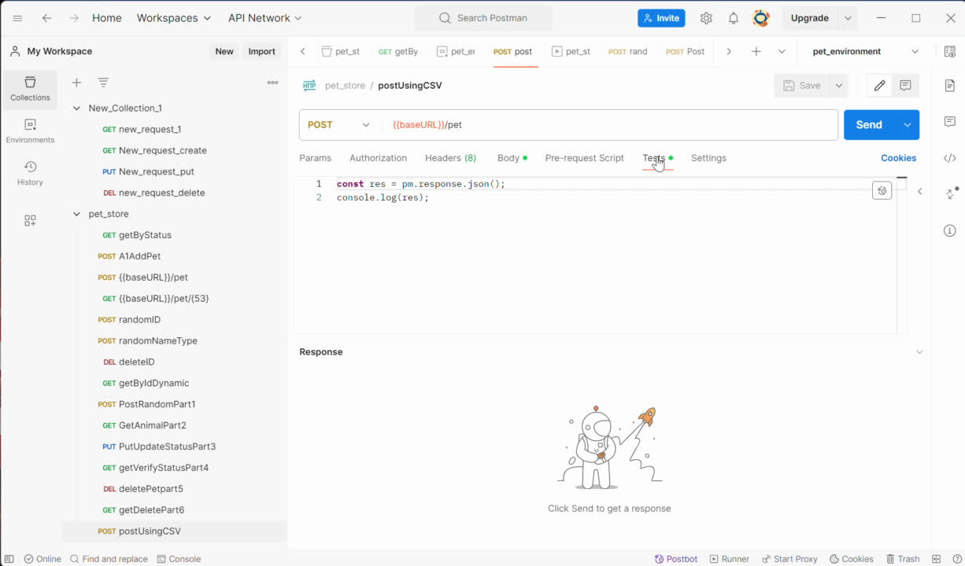

Slide 21
Issuses faced during
Our
IMPLEMENTATION
LEARNINGS
Variables not resolved
Environment not set properly
problem with adding correct base URL
Data types of objects body like for string not using double quotations properly .
Using Postman to call apis and test them
writing scripts
Using custom Variables
Using CSV files to run requests

Slide 22
THANK YOU

